Slide 1

Adolescent ADHD: Self, Peers and Parents
Judy Wiener, PhD
Professor, Human Development & Applied Psychology

Slide 2

Outline
The Team
Purpose of our research
Self Perceptions
Peer Relationships
Parenting
Mindfulness Intervention
Future Research
Web Site
Introduction from YMCA Academy
Refreshments
Break-out Groups
Think Tank

Slide 3
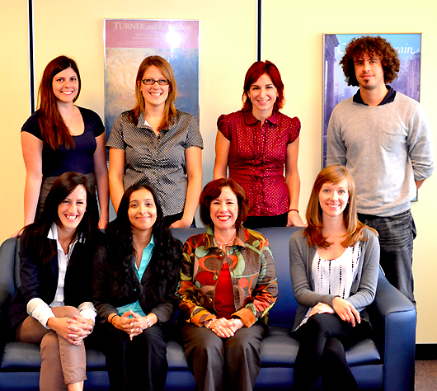
The Team

Slide 4
Purpose of our research
To improve the quality of life of adolescents with ADHD and their families by:
Understanding how teens with ADHD feel about themselves
Learning about the nature of the teens’ peer relations
  Bullying
  Friendship
Examining the impact of having a teen with ADHD on parents
  Parenting stress
  Parent-teen conflict
Investigating whether mindfulness cognitive behavioural therapy interventions help
This research was supported by the Social Science and Humanities Research Council of Canada

Slide 5

Self Perceptions, Positive Illusions and Stigma
Angela Varma

Slide 6
Self-Perceptions
ACADEMIC COMPETENCE
JOB COMPETENCE
BEHAVIOURAL CONDUCT
No differences in self-esteem

Slide 7
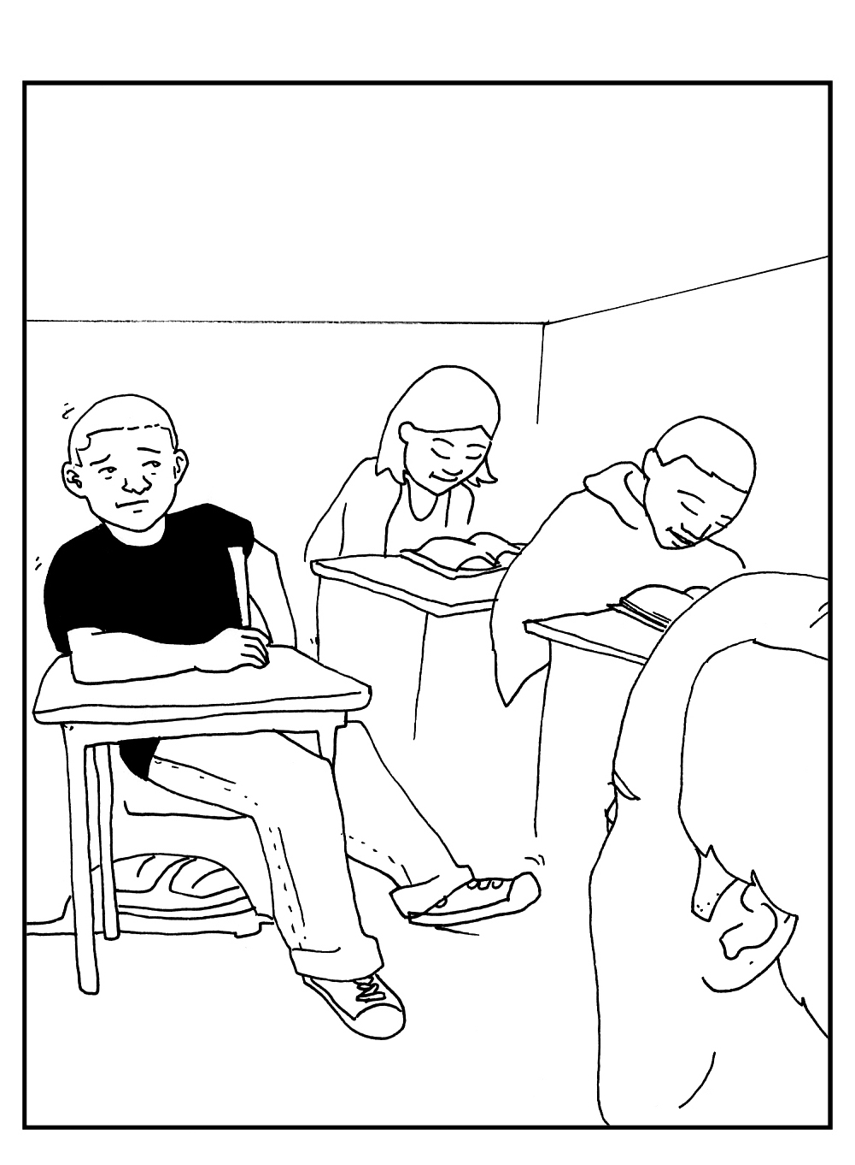
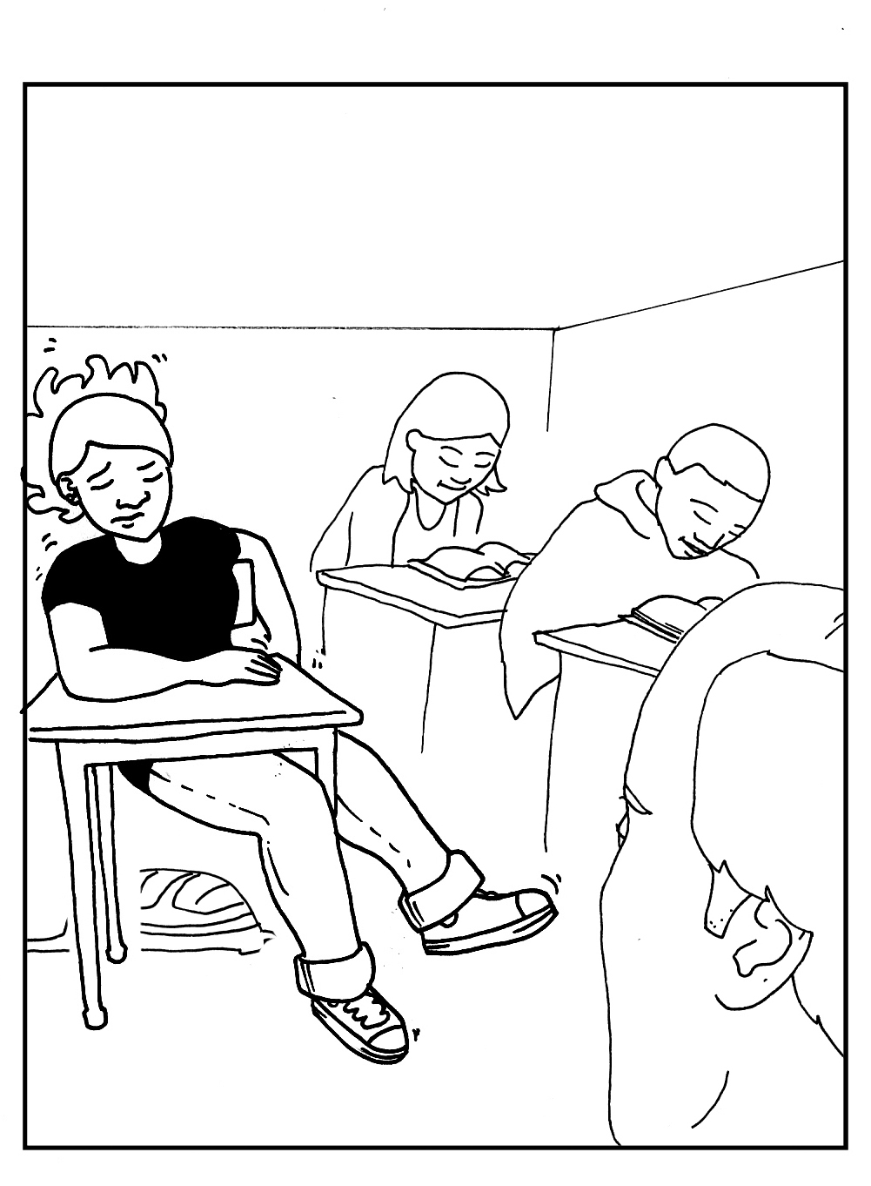
Positive Illusions for ADHD Symptoms (PIB)
ALEX: Fidgeting & Squirming
Notes:
Teens and their parents and teachers rate the teens in terms of their ADHD behaviours and other behaviours that commonly are associated with ADHD including oppositional (arguing), learning difficulties, peer relations problems

Slide 8
Positive Illusory Bias – Parents vs Adolescents
PIB Discrepancy Score
 | Sig | Eta
IA | *** | .189
HI | *** | .180
OD | ** | .133
LP | *** | .157
SP | * | .069
Notes:
Parent v. Adolescent ratings
- Note: Using Conners Parent and Self-Report + CBCL/YSR for Social Problems
- Used MANOVA over between subject MANOVAs, because moderate – high correlations between dependent measures (from .434 - .797)
Considered co-varying SES in MANOVA, but when ran correlations with dependent measures, it was not significantly correlated
MANOVA significant (p = .004) , followed up by one-way between subjects ANOVAs to examine where the group effect lies
Note: Limitation that Learning Problems subscales have a few different questions, majority are same. Therefore, re-ran creating my own LP scale (standardizing with z scores), effect still significant. In the graph, have discrepancy of T scores to keep it consistent with the other subscales.
Note: only displayed group effect because m.e. of gender is not significant
MANOVA assumptions:
- DVs are normally multivariately distributed (ok)
- Independent collection of observations (ok)
- Homogeneity of variance (violated, but characteristic of data and cannot be corrected)

Slide 9
PIB – Teachers vs Adolescents
PIB Discrepancy Score
Notes:
Teacher v. Adolescent ratings
- Using Conners Teacher + Self-Repot (note: no social problems)
- Used MANOVA over between subject MANOVAs, because moderate correlations between dependent measures (from .282 - .619)
Considered co-varying SES in MANOVA, but when ran correlations with dependent measures, it was not significantly correlated
MANOVA non-significant
Note: Limitation that Learning Problems subscales have a few different questions, majority are same. Therefore, re-ran creating my own LP scale (standardizing with z scores.
MANOVA assumptions:
- DVs are not multivariately normally distributed- but not a big concern in this case as MANOVA not-significant
- Independent collection of observations (ok)
- Homogeneity of variance (violated, but characteristic of data and cannot be corrected)

Slide 10
Stigma of ADHD and Problem Behaviours
Total Stigmatization
 | Sig | Eta
Grp | *** | .094
Notes:
MANOVAs chosen because low to moderate significant correlations between attributions
ADHD Mean = 15.60
Control Mean = 13.16
DON’T MENTION UNLESS ASKED
This one is total stigma – showing a group effect in the between subjects ANOVA
(but age effect approaches significance) is .080

Slide 11
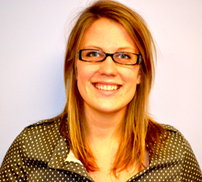
Peer Relations
Victoria Timmermanis

Slide 12
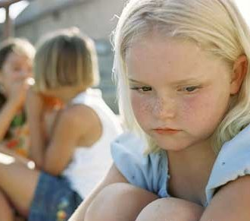
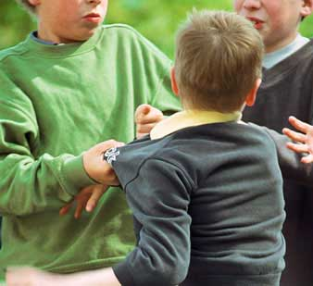
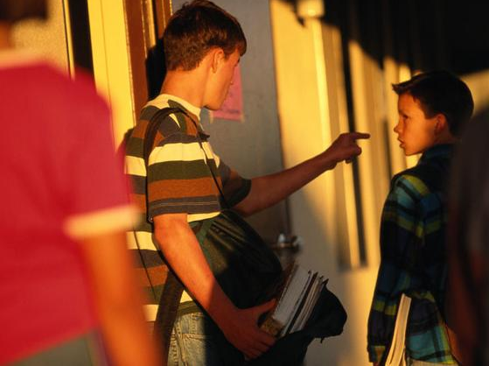
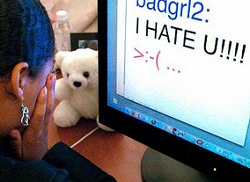
What is Bullying?
Bullying is… (Olweus, 1995)
  negative actions repeatedly and over time
  imbalance of power
  intended to cause harm
  Various forms…
Verbal
Physical
Cyber-Bullying
Relational
Notes:
-one or more children perform negative actions toward another child repeatedly and over time.
-bullying is characterized by an imbalance of power in which the victims cannot defend themselves (Olweus, 1995).
-These negative behaviours are intended to cause harm,
- Children may be involved as victims, bullies or both bullies and victims.

Slide 13
Impact of Bullying
Interviewer | How does it make you feel when kids bully you?
Alan | Lonely. Makes me feel embarrassed, sad, angry
Interviewer | What do you do?
Alan | I just walk away.
Interviewer | What do you do with all that anger & sadness?
Alan | I let it out when I get home… or I just deny. I go upstairs to my room, close the door, & start screaming & shouting at the top of my lungs.
Interviewer | Does that help?
Alan | NO
Shea & Wiener, 2003

Slide 14
Importance of Peer Victimization
Child anxiety & depression
Victim
Adult Victimization
Adult spousal & Child abuse, violent crime
Bully
Craig, 2008
Notes:
Bullying involves chronic physical, verbal or relational aggression by a bully twd a victim and by definition a balance of power
Olweus and colleagues in Norway were initial leaders
Self, parent, teacher, and peer report

Slide 15
TYPES OF BULLYING
Physical Bullying
  Pushing, hitting
Verbal Bullying
  Name-calling (weird, idiot, loser, ugly)
  Teasing regarding clothing
  References to sexual orientation (Ew, you’re so faggy)
Relational Bullying
  Most hurtful
  Exclusion, shunning, dirty looks
  Covert and hidden
Cyber Bullying
Power Imbalance
Chronic

Slide 16
“Frequent” Categorization
“frequent” bullying/victimization was defined as once a week or more
Notes:
The first classification of “victims” and “bullies” was based on the categories of Nansel and colleagues (2001) in which “frequent” bullying/victimization was defined as once a week or more.
This categorization was based on whether the adolescent or their parent reported that the adolescent had experienced victimization by peers or participated in bullying others at a rate of at least once/week.
Among adolescents with ADHD, 6 (15%) were categorized as “victims”, 1 (2.5%) as a “bully”, 3 (7.5%) as “bully/victims” and 30 (75%) were not involved.
Among adolescents without ADHD, no participants were categorized as a “victim” or “bully/victims”, 1 (4.2%) was categorized as a “bully” and 23 (95.8%) were not involved.
So – 25% of adolescents with ADHD and 4% of adolescents without ADHD are involved in bullying on a weekly basis
When using the once/week or more criterion, the categories of experiencing victimization and bullying others were too low to conduct statistical comparisons to identify risk factors for being categorized as a “victim” or “bully” based on ADHD status.

Slide 17
ADHD and Bullying: Adolescence
(Timmermanis & Wiener, 2011)
Notes:
This includes “ever” bullied or “ever” participated in bullying others in the last 2 months.

Slide 18
PREDICTORS OF VICTIMIZATION
Self-Perception of social support
VICTIM
ADHD
Parent rated peer problems
Timmermanis & Wiener, 2011

Slide 19
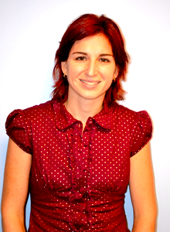
PARENT – ADOLESCENT CONFLICT
Clarisa Markel

Slide 20
Number of Conflicts out of 45

Slide 21

Specific Areas of Conflict
Parent Report
Making too much noise
Allowance
Lying
Getting up in the morning
Getting to school on time
Getting low grades in school
Getting in trouble at school
Coming home on time
Talking back to parents
Teen Report
Coming home on time
How money is spent

Slide 22
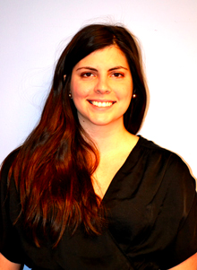
Parenting Stress
Daniella Biondic

Slide 23

WHAT IS PARENTING STRESS?
Parenting stress is a dynamic process that occurs when parents’ perceptions of the demands of parenting outweighs their perceptions of the resources for meeting those demands. (Deater Deckard, 2004)

Slide 24
Domains of Parenting Stress
Adolescent Domain
Parent Domain
Role Restrictions
Parent-Adolescent Relationship
Relationship with Partner
Moodiness
Challenging Behaviour

Slide 25
ADHD Mother vs. Control
Comparing parenting stress levels
 | Partial Eta
TS | .35 ***
AD | .61***
PD | .25**
APRD | .11*
Notes:
The first objective of the study was to determine whether mothers and fathers of adolescents with ADHD experience more parenting stress than parents of adolescents without ADHD.
As we can see…Mothers of adolescents with ADHD report sig. more stress in all domains.
TS and AD significant at .001
PD at .01
APRD at .05

Slide 26
ADHD Father vs. Control
Comparing parenting stress levels
 | Partial Eta
TS | .30 **
AD | .52***
PD | .04
APRD | .12*
Notes:
Fathers of adolescents with ADHD reported significantly more TOTAL stress and more stress in the ADOLESCENT and the ADOLESCENT-PARENT RELATIONSHIP DOMAIN than comparison fathers. NO differences were found in the PARENT DOMAIN
Total stress significant at .01
AD significant at .001
PD not significant
APRD significant at .05 level

Slide 27
Predictors of Maternal Stress
Total Stress
Notes:
The second objective of the study is to determine whether adolescent externalizing behaviours and parental ADHD symptoms, which are associated with parenting stress of parents of children with ADHD (Theule et al…)
Maternal inattention, parent ratings of inattention/hyperactive impulsive behaviour and externalizing problems were positively correlated with TOTAL STRESS
Results show that ADHD status, externalizing behaviour, and maternal inattention are SIGNIFICANT predictors of Total parenting stress (p-value of .000)
- ADHD STATUS and EXTERNALIZING BEHAVIOUR/MATERNAL INATTENTION PREDICT 54.4% OF THE VARIANCE

Slide 28
Predictors Paternal Stress
Total Stress
Notes:
Total stress was positively correlated with parent ratings of adolescent inattention, hyperactive/impulsive behaviour and externalizing problems.
In terms of total stress, ADHD status predicted 30.5% of the variance.
Although the externalizing behaviour composite predicted an additional 4.2%, this was not significant.

Slide 29
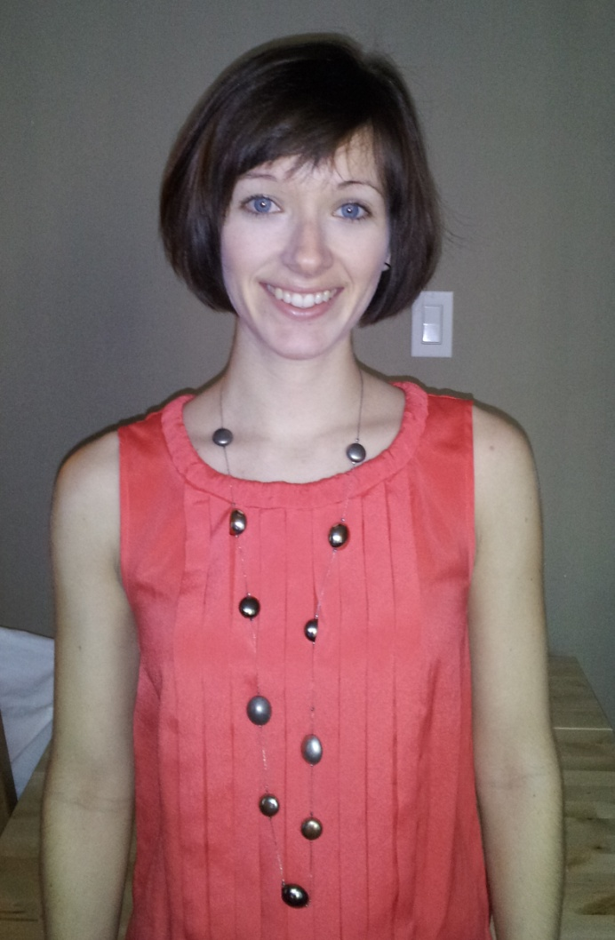
Mindfulness Intervention
Jill Haydicky & Carly Shecter
Collaborating with Joe Ducharme
Paul Badali
Karen Milligan

Slide 30
What is Mindfulness?
“The awareness that emerges through paying attention on purpose, in the present moment, and non-judgmentally to things as they are.”
-Williams, Teasdale, Segal & Kabat-Zinn (2007)
Two components
  Self-regulation of attention
  Accepting attitude toward experience

Slide 31
Mindfulness Martial Arts - Integra
20-week manualized program for adolescents with Learning Disabilities (LD)
Designed to increase
  self-awareness
  self-control
  adaptability
  social skills
Combines elements of mindfulness, cognitive behavioural therapy (CBT), and mixed martial arts.

Slide 32
Findings from Mindfulnes Martial Arts
Compared to Wait List control group, intervention youth improved on:
Teens with LD + ADHD:
  Parent-rated externalizing behaviour (e.g., aggression, defiance)
Teens with LD + Hyperactive/Impulsive Symptoms:
  Parent-rated social problems & self-monitoring
Teens with LD + Anxiety:
  Self report of anxiety
Haydicky, Wiener, Badali, Milligan, & Ducharme (2012).

Slide 33
Adapted AMBAT – Mindfulness Program for youth with ADHD and their Parents
Joint parent-adolescent 8 week mindfulness training program
Previous research by Bogels shows the program helps teens with ADHD with attention
Adapted by Haydicky & Shecter for Canadian context
Designed to
  Improve attention and focus
  Lower anxiety and stress
  Reduce parenting stress and parent-adolescent conflict
  Enhance positive interactions in families with an adolescent with ADHD

Slide 34
Preliminary Findings
Teens demonstrated reductions in
  Attention problems
  Peer relations
  Conduct problems
  Anxiety
  Depression
Parents reported
  Lower parenting stress
  Higher levels of mindful awareness
  Improved family functioning

Slide 35
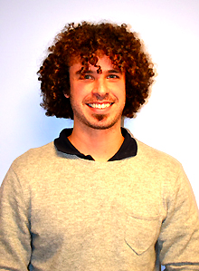
Current & Future Research
5 W’s of bullying
Relationship of social perspective taking and empathy with being a bully or victim
Romantic relationships
How parents cope with parenting stress
Impact of parenting stress on parenting behaviours
Parents’ involvement in their teens’ education
Further study of mindfulness and other interventions
Mobilizing knowledge to teens, parents, and teachers
Alan Rokeach

Slide 36
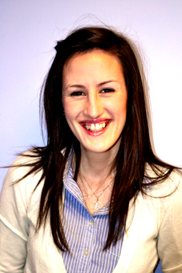
Thank you
Ashley Brunsek
Lab Manager

